Slide 1

The R Course for Analysts
Lesson 7: Doing Basic Statistical Analysis with R

Slide 2
References & Texts
I recommend the following resources, which I have made copious use of in developing this material:
Mahoney, M. (2019). Introduction to Data Exploration and Analysis with R. Bookdown.
Retrieved from https://bookdown.org/mikemahoney218/IDEAR/
Soetewey, A. (2022). Stats and R (Blog). https://statsandr.com/
Hadley Wickham & Garrett Grolemund
R for Data Science
O'Reilly and Associates, 2017 Freely accessible here: https://r4ds.had.co.nz/index.html
Wickham, H. Tidyverse: R Packages for Data Science https://www.tidyverse.org/

Slide 3
Introducing Basic Concepts & Vocabulary: Types of Data
continuous: numeric data with a potentially infinite number of intermediate values
example: measures
discrete: data that is restricted to a certain range of values
examples: counts – must be a whole integer;
scores / percentages – must be between 0 and 100
categorical: data that is restricted to a certain set of values
examples: all the zip codes, all the colors of the Ford Fiesta
ordinal: a type of categorical data that has a natural progression
examples: Likert data and other ratings scales, sometimes range buckets
nominal: a type of categorical data that DOES NOT have a progression
examples: colors, types, products, etc.
normal: data is normally distributed when:
the median = the mean (or just about)
2/3rds of the data are within 1 standard deviation of the mean
95% of the data are within 2 standard deviations of the mean, and
99% of the data are within 3 standard deviations of the mean
uncommon in nature, but often ASSUMED by statistical tests
skewed: data where the median and the mean values are not equal

Slide 4
Introducing Basic Concepts & Vocabulary: Measures & Estimates
n: The number of observations of a dataset or level of a categorical variable
mean: The average of a dataset, defined as the sum of all observations divided by the number of observations
trimmed mean: The mean of a dataset with a certain proportion of data not included; example: the “10% trimmed mean” trims 10% off the ends of the data and gives you the mean of the middle 80%.
variance: a measure of the spread of the data
standard deviation: the amount that any given observation can be expected to vary from the mean
standard error: the error associated with a point estimate of the sample; eg: sd(Vector)/sqrt(length(Vector))
median: a robust estimate of the center of the data
mode: the most common value for a given data point
minimum: the smallest value
maximum: the largest value
range: maximum - minimum
quantile: the n quantile is the value at which n% of the data is below that value; ranges from 0 to 1 – if you multiply the quantile by 100, you get the percentile. Quartiles are the 0.25, 0.5 and 0.75 quantiles.
interquartile range: the middle 50% of the data, contained between the 0.25 and 0.75 quantiles
skew: The relative position of the mean and median; at 0, mean = median
kurtosis: the size of the tails in a distribution; values much different from 0 mean the data is not normally distributed

Slide 5
Introducing Basic Concepts & Vocabulary: Testing Concepts
Estimate: a statistic calculated from your sample data; we are approaching (hopefully) a population value
Hypothesis testing: comparing the NULL hypothesis (usually – that two quantities are no different) to an alternative hypothesis. The alternative hypothesis in a two-tailed test is that the quantities are different, in a one-tailed test, the alternative hypothesis is that one quantity is larger or smaller than the other.
P-value: The probability of seeing an effect of the same size as our results given a random model; not always useful. Some people / journals have banned them. High p-values often mean your independent variables are irrelevant, but low p-values don’t guarantee their importance.
Robustness: A test or model is ‘robust’ if it produces estimates that are less sensitive to the influence of outliers
Sensitivity testing: Changing inputs to a model or test to see if they radically change the results; a method for helping determine a model’s robustness
type 1 error: incorrect rejection of the NULL hypothesis
type 2 error: incorrect rejection of the alternative hypothesis
power: the likelihood that a test could correctly affirm the alternative hypothesis; the higher the power the lower the likelihood of type 2 error

Slide 6
Introducing Basic Concepts & Vocabulary: Tests
Correlation: calculates how closely related two variables are. Types:
Pearson’s – assumes normality, measures linear correlation
Spearman’s and Kendall’s – do not assume normality and measure non-linear correlation
T-test: a method for comparing the means of two groups
Chi-squared test: a test to see if two categorical variables are related
ANOVA (Analysis of Variance): A test to identify the impacts of one or more categorical variables on one or more numeric response variables; really a type of linear model
CMH (Cochran-Mantel-Haenszel) testing: Compare multiple 2x2 tables for a statistically-significant difference
Fisher’s Exact testing: determine whether or not there is a significant association between two categorical variables – works with very small sample sizes
Linear regression: predicts the value of a response variable at given values of independent predictor variables
Logistic regression: a linear regression model where where the response variable is a binary vector, and where independent variables are related to the log odds of the binary outcome

Slide 7
Introducing Basic Concepts & Vocabulary: Non-Parametric Tests
When to use:
data not normally distributed
outcome is an ordinal variable or rank
there are definite outliers
outcome has limits of detection (outcome range is limited by instrument precision)
Examples: (outcomes must be ordinal, ranked or continuous)
Mann Whitney U / Wilcoxon Sum Rank test: Allows comparison of two groups with regard to an outcome, even if data sets are small and the outcome is not normally distributed. NULL hypothesis: the groups are the same with regard to the outcome. Examples: placebo vs. control groups against an outcome like # of feet walked, or # of asthma attacks, student outcomes in a small course this year vs. last year
Wilcoxon Signed Rank test: Allows comparison of two sets of measures, even if data sets are small and the outcome is not normally distributed. NULL hypothesis: the median difference is zero. Examples: performance before and after an intervention
Kruskal-Wallis test: Allows comparison of outcomes among more than two groups; no normality or linearity assumptions (as there are with ANOVA). NULL hypothesis: The k population medians are the same. Examples: #of pounds lost by people following 4 different diets

Slide 8
Introducing Basic Concepts & Vocabulary: Modeling Concepts
R²: The percentage of variance in your data explained by a regression model (higher is better)
RMSE (root mean squared error): Standard deviation of the residuals - tells you how well your model fits the data (lower is better)
ROC (receiver operating characteristic) curve: AUC (area under the curve) represents the accuracy of a logistic regression model, with random guessing having an AUC of 0.5 and a perfect model having an AUC of 1
AIC (Akaike’s information criterion): the model with the smallest AIC is your best model; however, models with AIC within 2-4 of one another are statistically identical; if your model is statistically identical to the NULL model: lm(ResponseVariable ~ 1),then it is useless
Cross validation: A method in which data is split into separate training and testing datasets, to evaluate the performance of the model on new data. In k-fold cross validation, data is split into k sets, trained on all but one, and tested on the one held back, and this is repeated until all k sets have been used as hold out. Outcome / accuracy scores are averaged across the repetitions
Confusion matrix: table showing how often your model predicted an outcome or score correctly and how often it performed incorrectly
A/B testing: when people are divided into groups at random to test out two versions of a product or process. Should always be accompanied by A/A testing

Slide 9
Calculating Basic Statistics with R

Slide 10
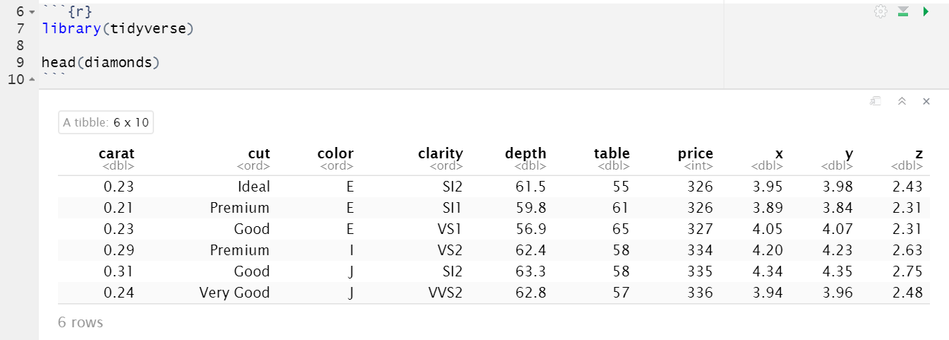
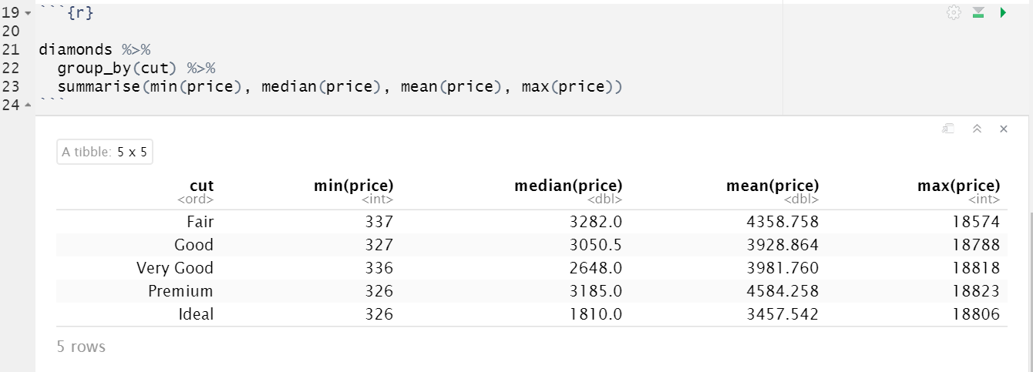
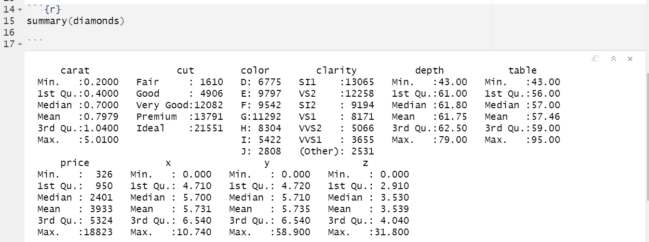
Summarizing:
Mean, Min, Median, Max, Quantiles, Quartiles and the Interquartile Range
As we saw in the last lesson, the summarize (or ‘summarise’, your choice!) function allows us to calculate summary statistics easily for a data set that is in tidy format.
The ‘summary’ function also provides a handy way to generate all basic summary statistics for a column or data frame.

Slide 11
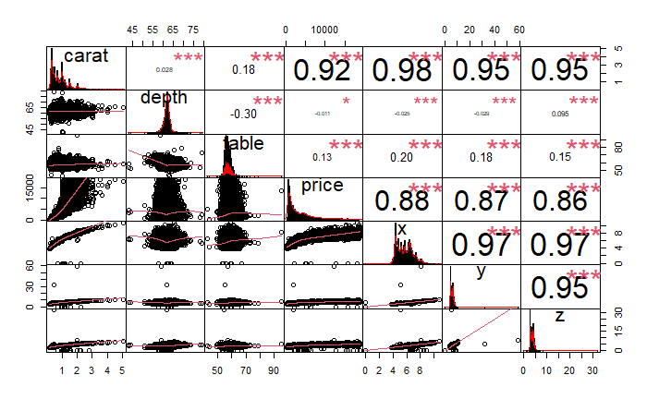
Looking at Correlations
Correlations between data points in a data set can help you see if data points vary in the same direction, in opposite directions, or if they are likely unrelated. Pairplots can also help you get the lay of your data’s landscape.
The chart.Correlation function of the PerformanceAnalytics
package is a shortcut to create a correlation plot in R with histograms, density functions, smoothed regression lines and correlation coefficients with the corresponding significance levels (if no stars, the variable is not statistically significant, while one, two and three stars mean that the corresponding variable is significant at 10%, 5% and 1% levels, respectively) .
Correlations, histograms, and density functions for the diamonds data set

Slide 12
Descriptive Statistics
It is very important to always look at basic statistics about your data set before beginning an analysis.
Sometimes, analysts forget how important this is, but descriptive statistics, histograms, boxplots and the like not only describe the data, they also help determine whether or not inconsistencies are present that might influence the analysis.
Descriptive statistics can answer the following important questions before the analysis proceeds:
How much missing data do I have?
Do I have potential outliers?
Are my standard deviation and standard error values large relative to the mean?
In what range do my data fall for each category I’m interested in comparing?
Looking at histograms or other plots can also put you on the right track as far as what distribution might most closely match your data.

Slide 13

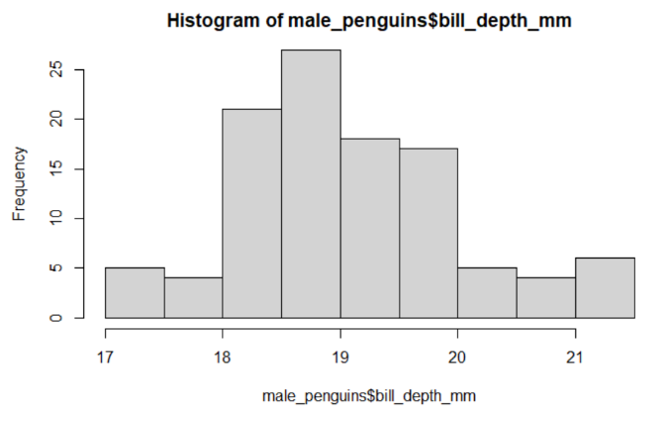
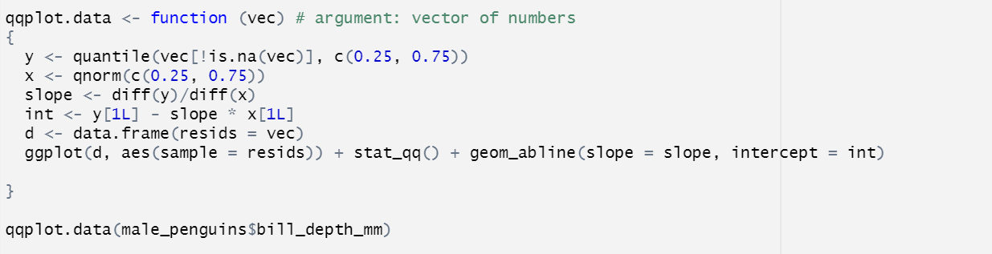
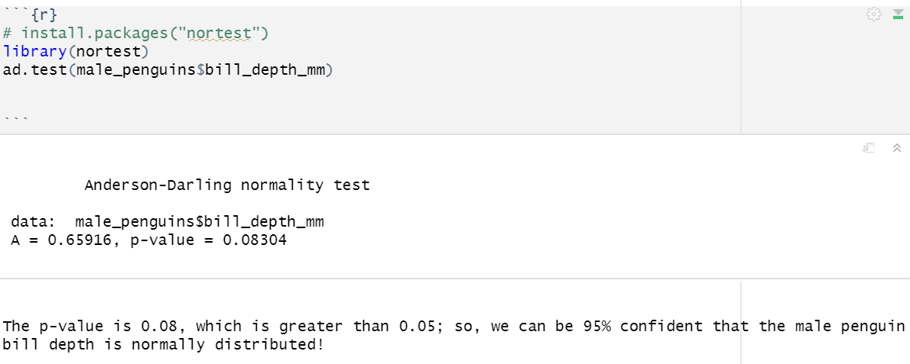
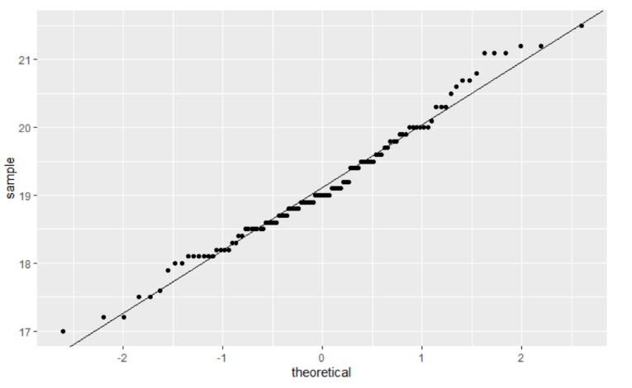
Are my data normal?
Examine the histogram
Examine the Q-Q plot
Perform a test and look at the shape of the residuals
Perform a test:
Kolmogorov-Smirnoff – for continuous data (no repeats), can also be used to detect other distributions, can be used to tell if two data points have the same distribution as each other
Anderson-Darling – preferred for discrete, measures
Shapiro-Wilks – sample size must be between 3 and 5,000
IN EACH CASE, the NULL hypothesis is that the data are normal, so you do not want a significant p-value.

Slide 14
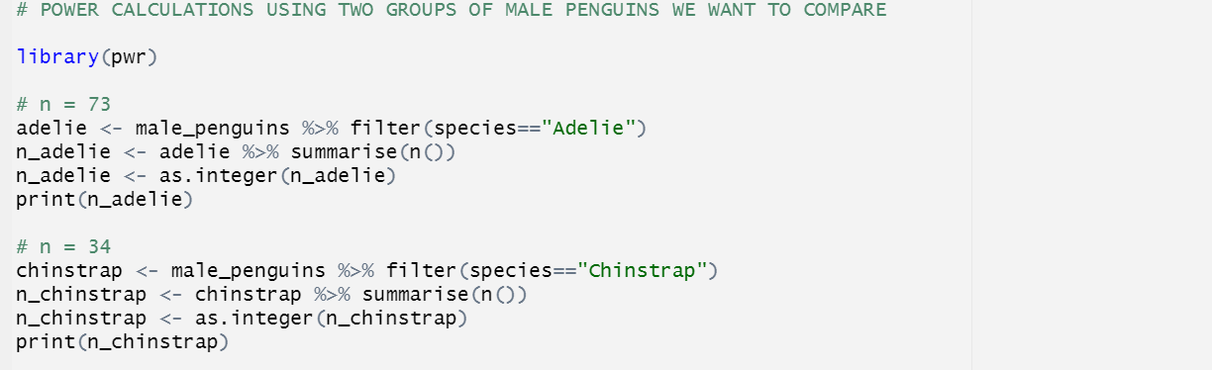
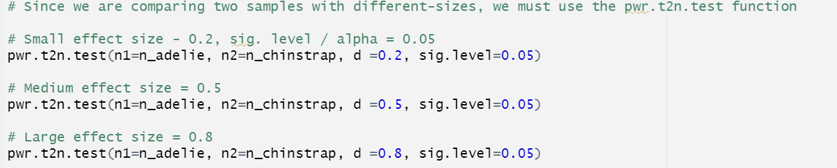
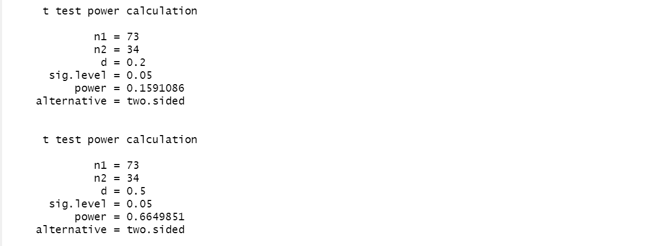
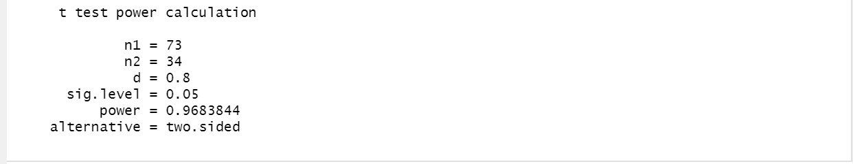
Power calculation and Significance level
Power calculation allows us to:
a) Determine the sample size required to detect an effect of a given size with a given degree of confidence, or
b) Determine the probability of detecting an effect of a given size with a given level of confidence, under sample size constraints.
Based on how certain we want to be of an effect of a given size, we might need more data!
We often focus on whether two groups are statistically significantly different, but more important is how different they are (or aren’t). This is called the ‘effect size’. If the effect size is very small, while the two groups may be different, it might not matter much in the real world.
Error & Power
Type I error is when we mistakenly reject the NULL hypothesis (we say two groups are different when they’re actually the same). Type II error is when we mistakenly reject the ALTERNATIVE hypothesis (we say the groups are the same when they’re actually different).
Power is the probability of finding an effect that is present, or 1 – probability(type II error).
Significance level, on the other hand, is the probability of finding an effect that is not there, or probability(type I error).

Slide 15
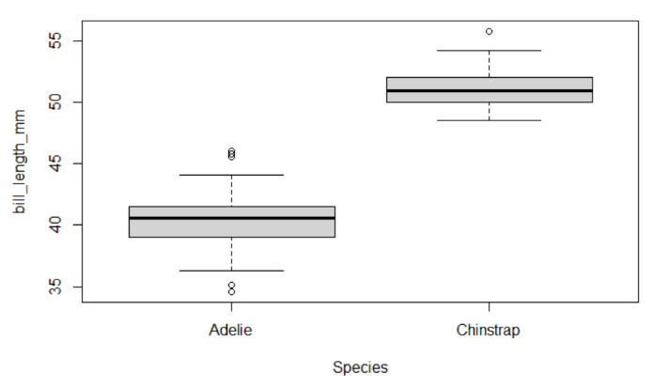
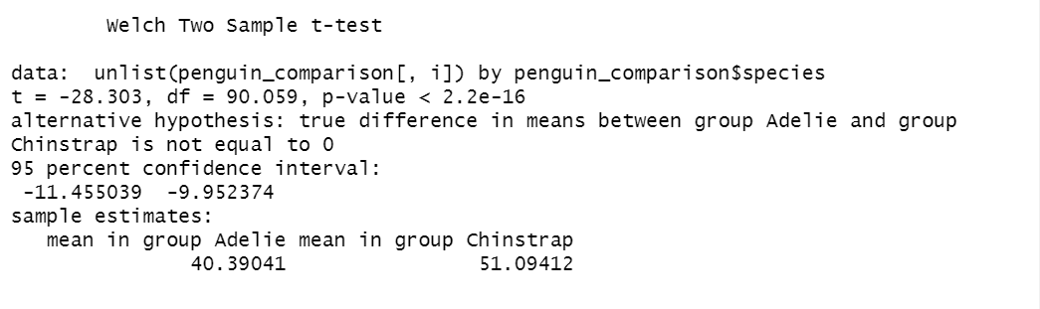
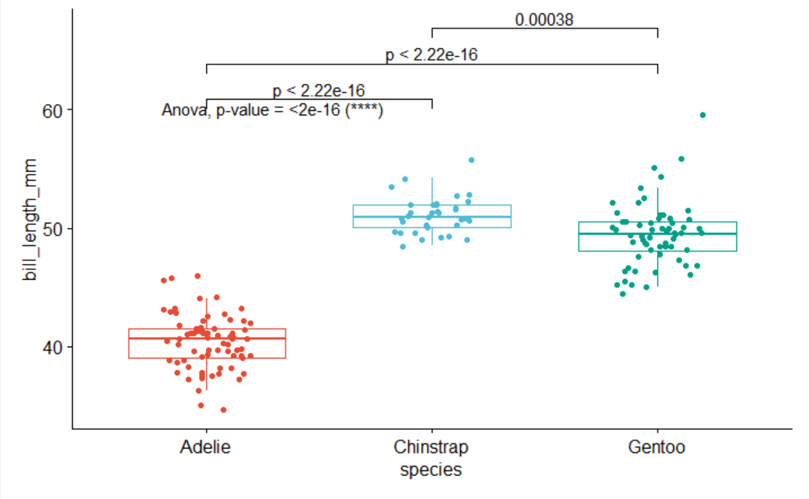
T-Test:
Tests on Normal Data
T-testing – compare means of two groups
(Note: the paired t-test compares measures on the same group at two different times.)
ANOVA – compare one or more groups
Simple linear regression – compare independent impacts on a continuous outcome variable
Simple logistic regression – compare independent impacts on the log odds of a binary outcome variable
*Regression is outside the scope of what I am presenting in this lesson. When evaluating regression models, the following metrics apply:
Linear Regression: Adjusted R2
Logistic Regression: Area under the ROC curve (AUC)
Nearly any model: RMSE, AICc
Entire tutorial on regression: https://www.alldatascience.com/statistics/linear-and-logistic-regression-with-r/
ANOVA:

Slide 16
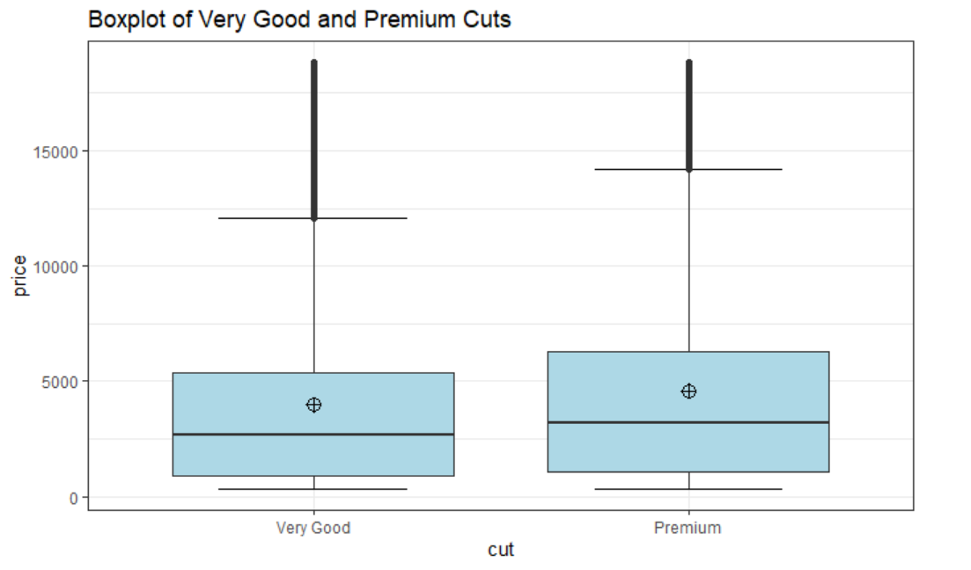
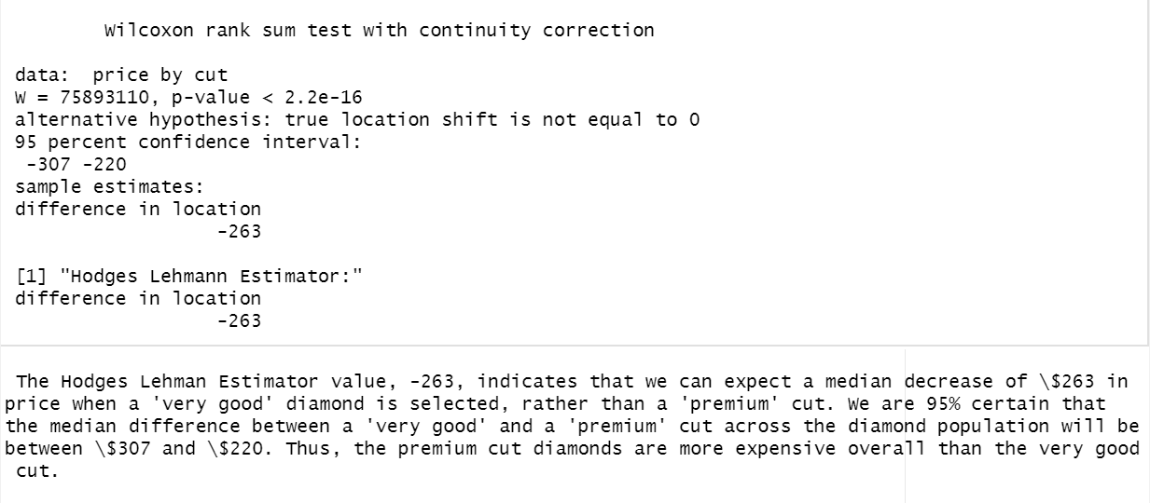
Doing the Mann Whitney U Test
A non-parametric test – works on non-normal data, small sample sizes.
AKA “Wilcoxon Rank Sum Test”
Let’s say you wanted to know if prices for two different cuts of diamonds are significantly different, and how different.
Price data pretty much never follows a normal distribution, so a T-test (or, if we were comparing 3 cuts, ANOVA) would not be appropriate this time. Enter the Mann Whitney U Test!
When we use the Mann Whitney U Test, we are testing to see if mean ranks differ between groups. Since mean ranks approximate the median, some analysts will say the test looks for median differences. We can again look at boxplots before performing this test, but we need to focus in on the location of the medians (50%) this time, not the means. It also makes sense to look at the # and weight of outliers.

Slide 17
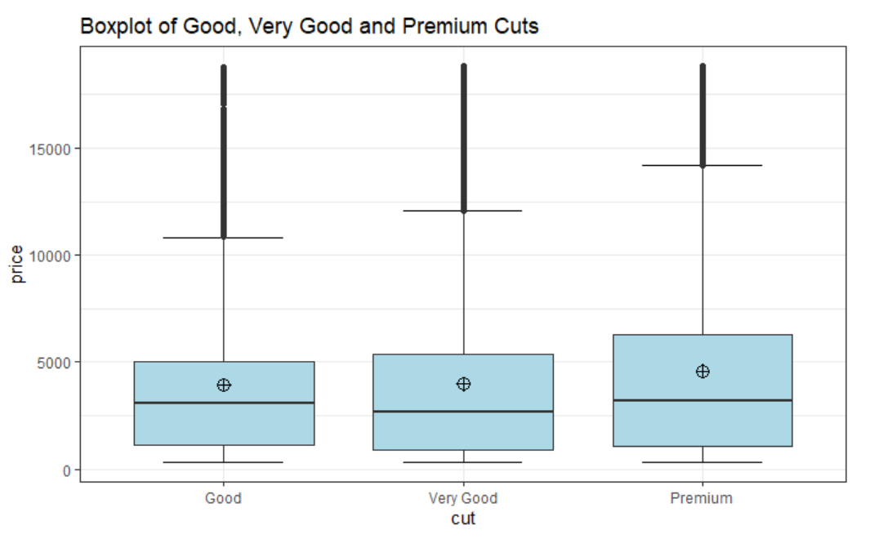
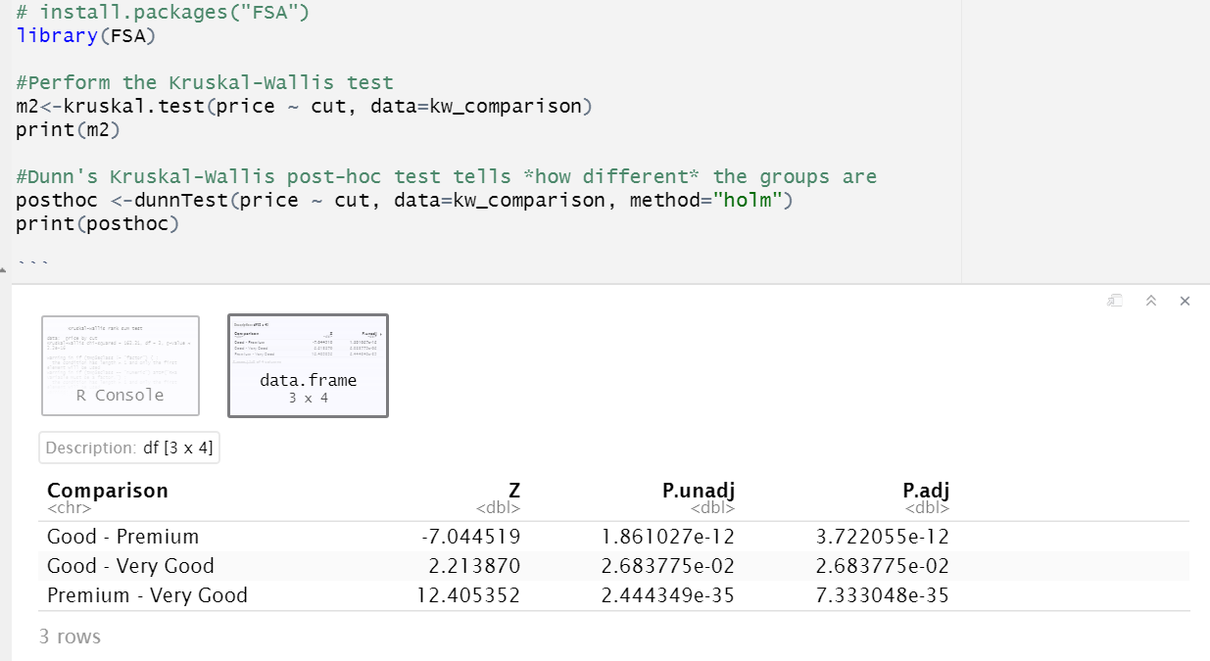
The Kruskal-Wallis Test
Comparing non-linear outcomes across more than 2 groups.
Just as we shifted from comparing two groups to three groups when we compared t-testing and ANOVA, we’ll do the same here. Instead of just comparing two groups of diamonds, we’ll add in a third group.
# The Kruskal-Wallis test; an alternative to ANOVA
In this case, all three groups are significantly different from one another in price.

Slide 18
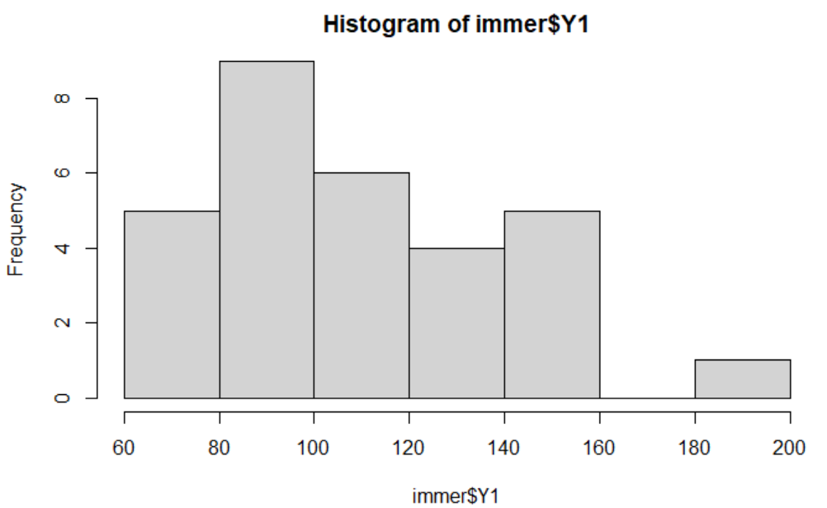
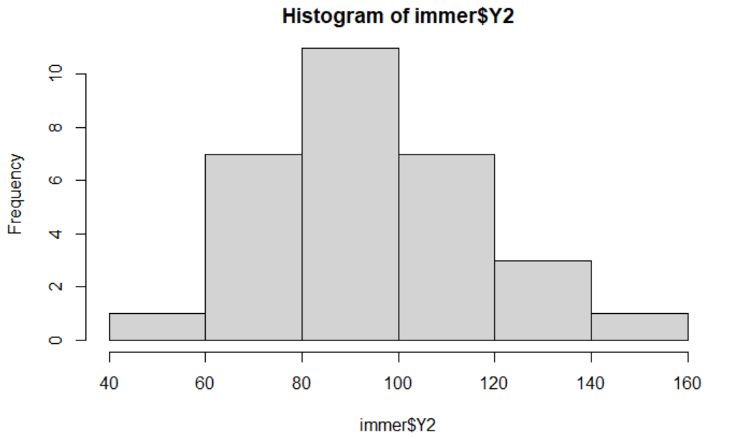
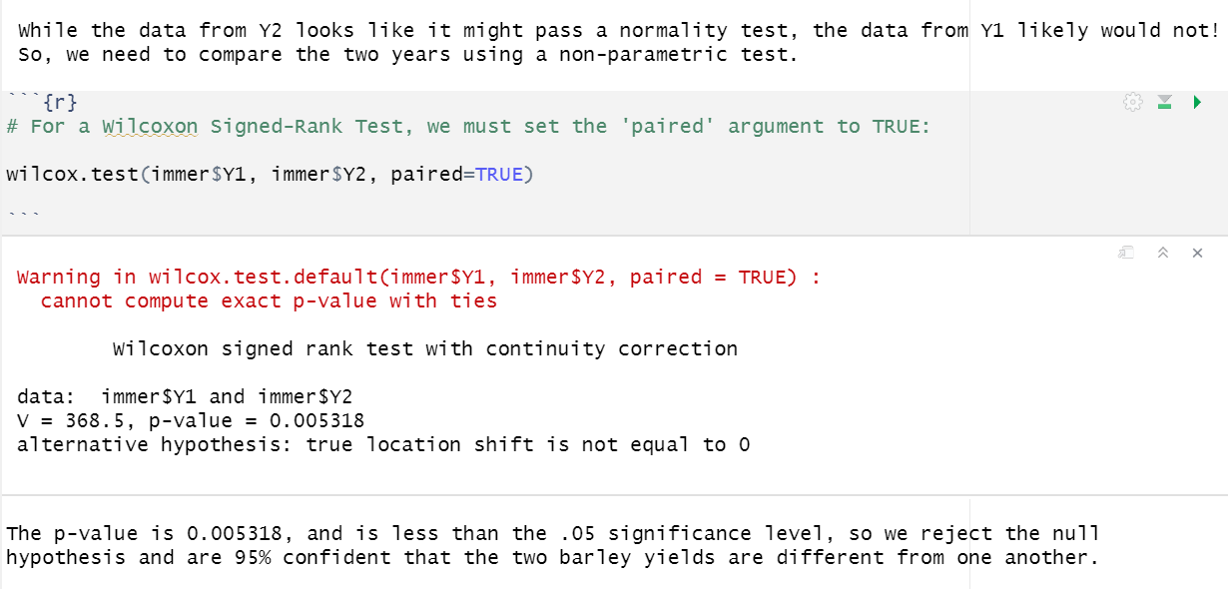

Doing the Wilcoxon Signed-Rank Test
# The Wilcoxon Signed Rank Test
The Wicoxon Signed Rank Test:
A non-parametric alternative to the paired-t-test; for comparing the same group twice, during two different points in time against a continuous outcome when the distribution of the outcome variable is non-normal.
For this example, we’ll look at barley yields in two different years to see if they are statistically different, and to what extent.

Slide 19
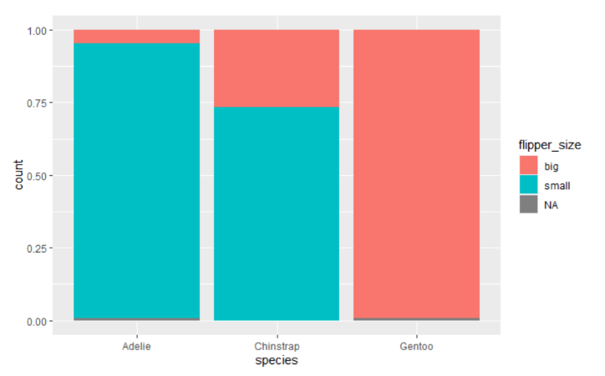
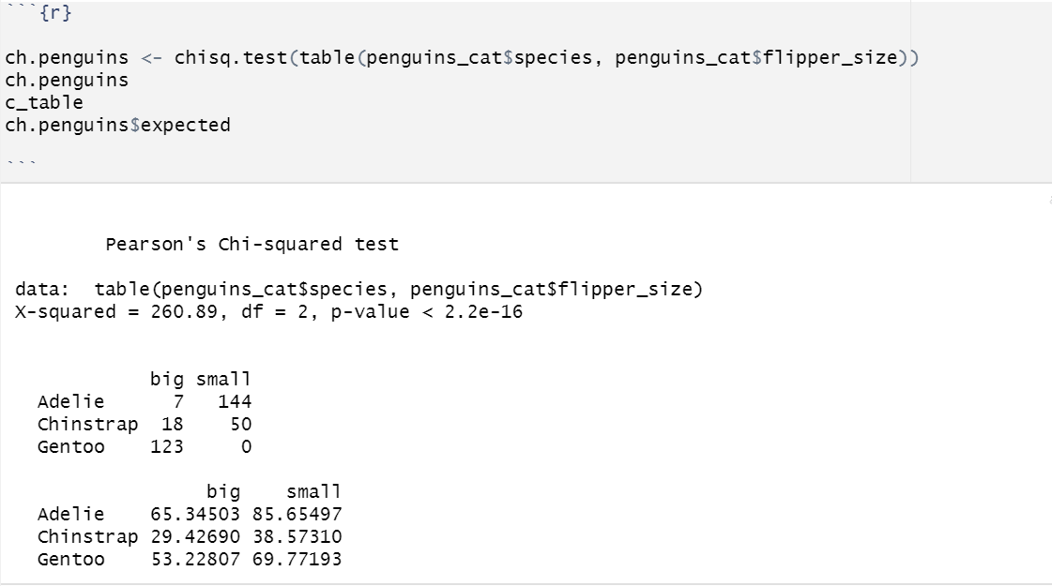
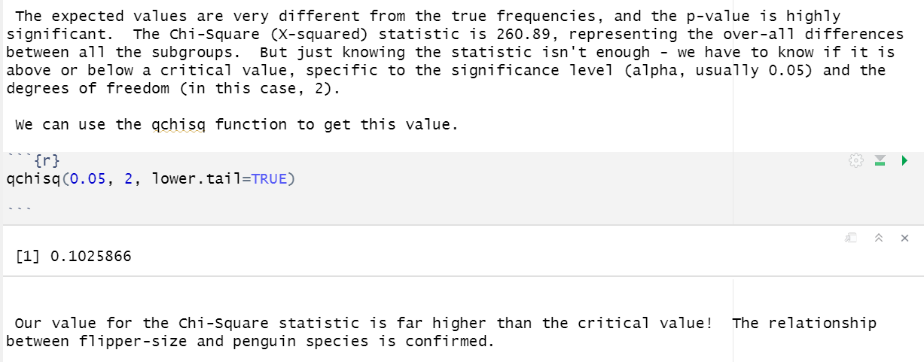
The Chi-Square Test of Independence
The Chi-Square Test
The Chi-square Test of Independence tests whether there is a relationship between two categorical variables.
The NULL hypothesis for this test is that the two variables are independent – that knowing something about one doesn’t help you determine the value of the other. By contrast, the alternative hypothesis says that the values are dependent – that if you know something about one, that will help you know something about the other.
The test works by comparing the observed frequencies in a sample to the expected frequencies provided there was no relationship between the two variables.
To perform this test we’ll use a modified version of the penguins data set, creating a categorical variable ‘flipper_size’ using the flipper_length_mm variable.

Slide 20
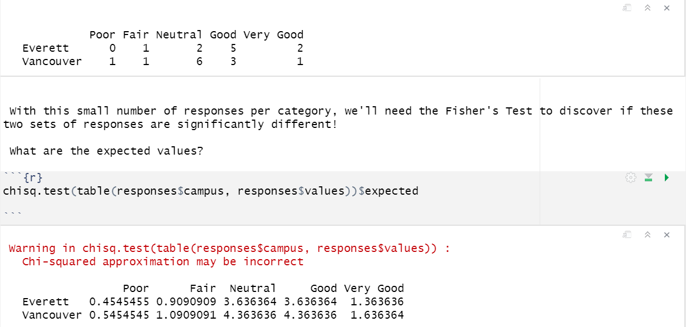
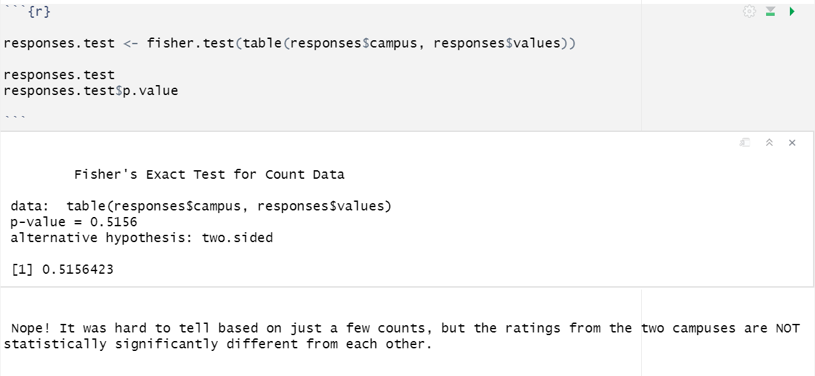
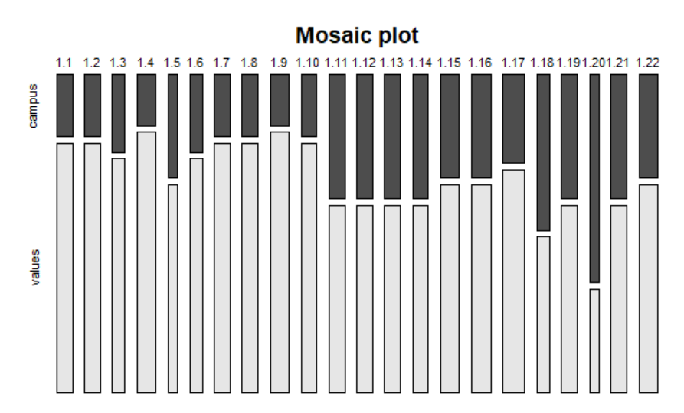
Fisher’s Exact Test
Fisher’s Exact testing
Sometimes we want to perform a Chi-Square Test, but we have a very small number of samples. So few in fact, that the expected values in at least one of the table cells of our contingency table are less than 5.
For instance, let’s say we wanted to compare Likert ratings of a clinical activity that occurred on two different campuses, ‘Vancouver’ and ‘Everett’, but there are only a few students who answered the question from each Campus. Fisher’s Exact test can be used in this case. (Note: this data is made up.)

Slide 21
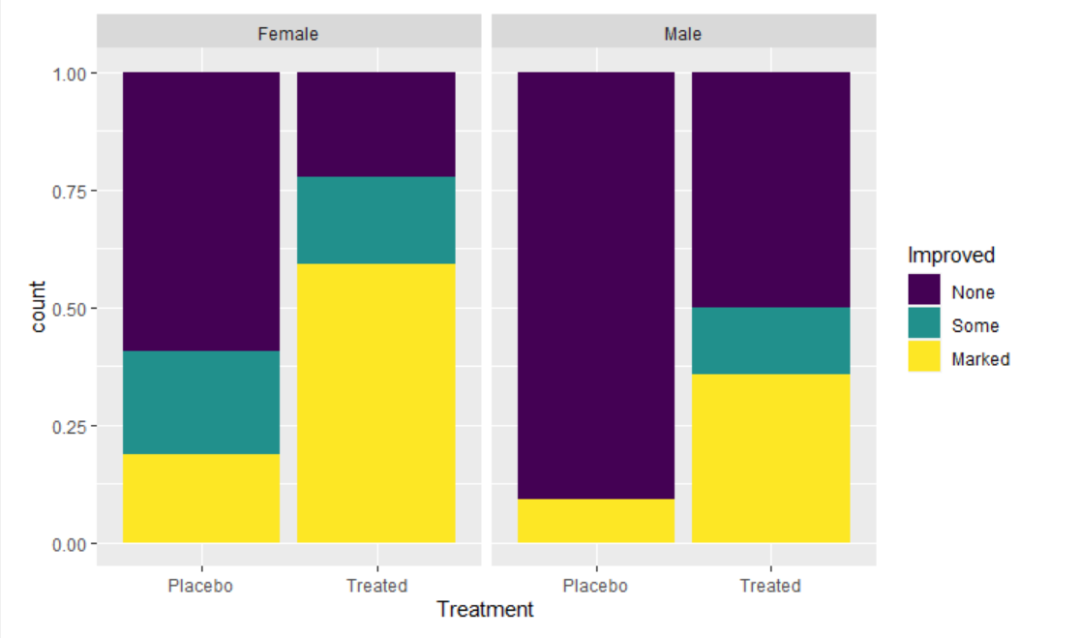
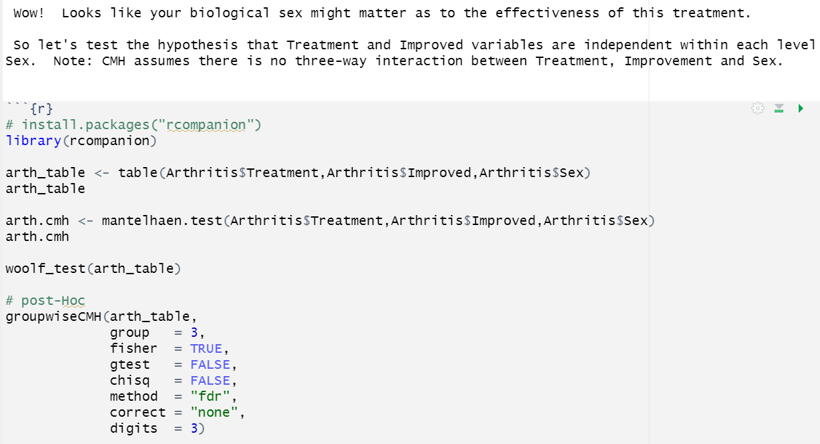
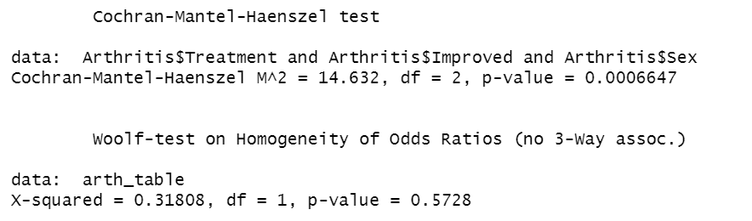
The Cochran-Mantel-Haenszel (CMH) Test
The Cochran-Mantel-Haenszel Test, or CMH, is an extension of the Chi-Square test that is very commonly used in research. It examines the significance of the association between two categorical variables where they are conditionally independent when stratified by a third variable.
For instance, in the vcd library, there is data on Arthritis treatment and response. The Chi-Square Test looking at the difference in “Improved” by “Treatment” shows that the Treatment group had significantly better outcomes than the Placebo group. But what happens when we stratify the relationship by biological Sex?
Does the treatment work equally well for males and females?

Slide 22

Creating Beautiful Tables in R
This online resource is an absolute must for anyone who wants to use R to create beautiful, interactive tables:
Keyes, D. (2019). How to Make Beautiful Tables in R. R for the Rest of Us.
Retrieved from: https://rfortherestofus.com/2019/11/how-to-make-beautiful-tables-in-r/
The kableExtra documentation is available here:
https://cran.r-project.org/web/packages/kableExtra/vignettes/awesome_table_in_html.html#Overview

Slide 23
Homework – Lesson 7
Introduction to Statistics Using R
Review the companion R notebooks for this lesson, “Basic Statistics with R”. Create a new R Notebook and do the following 2 exercises. You can use a copy of last week’s homework if you wish.
I. Basic Summary Statistics & Tables
Read in the P2-movie-ratings.csv file from last week
Calculate min, median, mean, max and range for audience ratings and budget variables
Calculate the .10, .25, .50. .75, .90 quantiles; which are quartiles?
Put the quartiles in a table using the kable package
Calculate the interquartile range for audience ratings and budget. Are there outliers?
Are the distributions of audience ratings and budget the same or similar? Generate a histogram and Q-Q plot for each of these data points, and explain why you think the data point is normally distributed or not. Test your hypothesis with the Anderson Darling test.
ANOVA or Kruskal-Wallis?
Choose any data set, X, with at least 2 continuous variables and one categorical variable / factor with 3 or more levels. Examine the X data set with N values / rows; do some descriptive statistics to review distributions, outliers, data types and empty values.
Compare one or more continuous variables across 3 levels of the factor. Use either ANOVA or Kruskal-Wallis testing.
Perform at least one test of normality and interpret the p-value – what is the appropriate test for this data / outcome variable? Why?
Explain the NULL and alternative hypotheses.
Perform the test and explain the results – do you want to accept or reject the NULL hypothesis and why? How confident are you?

